Slide 1
Childbirth, A Symbol of The End of This Age 分娩 ，这世代终结的象征

Slide 2
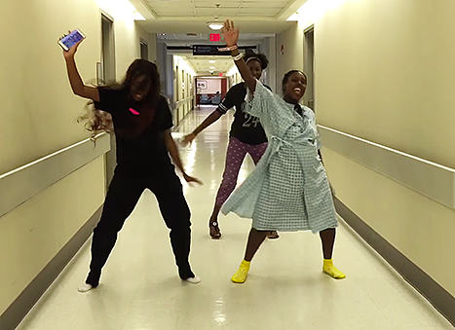

Slide 3
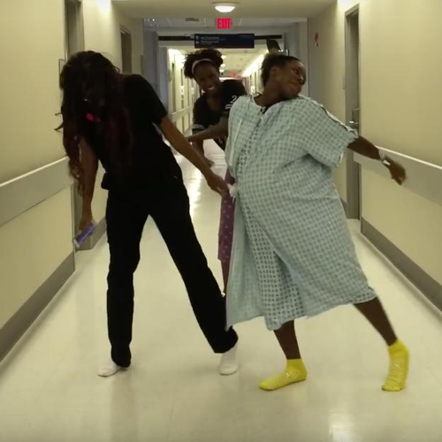

Slide 4
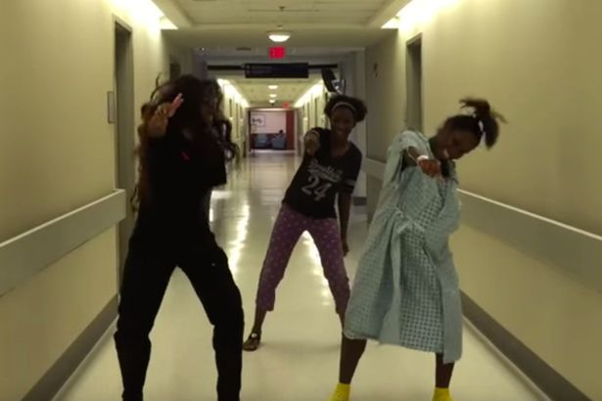

Slide 6
Labour and childbirth a symbol of the end of this age 女人分娩 是这世代终结的一个象征

Slide 7
Resurrection of Jesus 耶稣的复活

Slide 8
John 约翰福音 16.16, 20
¹⁶ After a little while you no longer will see me, and once again a little while, and you will see me.
²⁰ Most assuredly I say to you, you will weep and lament, but the world will rejoice; and you will be sorrowful, but your sorrow will be replaced by joy.
¹⁶ 不久，你们不会再看见我；再过不久，你们还要看见我。 ²⁰ 我实实在在告诉你们，你们要痛苦哀号，使人却要欢喜；你们要忧愁，但你们的忧愁要变为喜乐。

Slide 9
John 约翰福音 16.21-22
²¹ When a woman goes into labour, she has pain. But after her child is born, she no longer remembers her pain because of the joy that a human being was born into the world. ²² You also, therefore, now have pain. But I will see you again, your heart will rejoice, and no one will take away your joy.
²¹ 女人临盘时会有忧愁，因为她的时辰到了；然而生下孩子，她就忘了分娩的痛，因为欢喜一个人儿诞生到世上来。²² 如今你们也要忧愁；但我必再见到你们，你们的心就会喜乐，你们的喜乐是没有人能夺去的。

Slide 10
Colossians 歌罗西书 1.18
¹⁸ He (Jesus) is the head of the body, the church; and he is the beginning, the firstborn from the dead; so that he might come to have preeminence.
¹⁸ 他（耶稣）是身体的头，这身体就是教会。他是元始，是死人中首先复生的，好让他在凡事上居首位。

Slide 11
Day of Resurrection of The new mankind headed by Jesus 以耶稣为首的新人类的复活日

Slide 12
wars increase of lawlessness apostasy false prophets 战争 不法的事日益恶化 离经叛道 假先知蛊惑群众

Slide 13
Matthew 马太福音 24.6-8
⁶ You will continually hear about wars and rumours of such. Make sure you do not become terrified by these. For conflicts must arise, but the end is not yet reached. ⁷ For nation will become aggressive against nation, and kingdom against kingdom. There will be famines and earthquakes in various places. ⁸ All these phenomena are the beginning of birth-pang.
⁶ 你们要听见战争，也听见战争的风声；你们不要惊慌，因为这是免不了的，不过结局还没有到。
⁷ 一个民族要起来攻打另一个民族，一个国家要起来攻打另一个国家，到处都有饥荒和地震。
⁸ 这一切，只是分娩之痛的开始。

Slide 14
wars increase of lawlessness apostasy false prophets rise of the Antichrist 战争、冲突 不法的事日益恶化 背教、变节 假先知蛊惑群众 敌基督的出现

Slide 15
Matthew 马太福音 24.33
³³ In the same way when you see all these happenings, you will recognise that it is near—right at the doors!
³³ 同样，当你们看见这一切，就知道人子已经近在门口了。

Slide 16
Daniel 但以理书 7.13-14
¹³ With the clouds of heaven one like a son of man was coming. He came up to the Ancient of Days (in heaven) and was presented before Him. ¹⁴ And to him was given dominion, glory and kingdom. That all peoples and nations might serve him. His dominion is everlasting. His kingdom is one which will not be destroyed.
¹³ 我在夜间的异象中，看见有一位像人子的，驾着天云来到万古常在者那里，被引领到他面前。¹⁴ 他得了权柄、尊荣和国度，各国、各族的人都侍奉他。他的权柄是永远的，他的国永不败坏。

Slide 17
Daniel 但以理书 12.2
² Many of those who sleep in the dust of the earth shall awake, some to everlasting life, some to shame and everlasting contempt.
² 必有许多睡在尘土中的人醒过来，有的要的永生，有的要受羞辱，永远被憎恶 。

Slide 18
A lesson from childbirth 分娩的启迪

Slide 19
Learn 学习

Slide 20
Stay calm 保持平静

Slide 21
Keep active 保持活动

Slide 22
Support 支持

Slide 23
Think baby only 记住，孩子很快就生下来了

Slide 24
Wars, pestilences = contractions Rise of Antichrist = labour starts (last 8 hrs) Tribulation (last 3 ½ years) = final push (last 1-2 hrs) Resurrection = birth 战争、瘟疫 = 阵痛 敌基督的出现 = 分娩 （最后8小时） 大灾难（最后3年半） = 最后冲刺 （最后1-2小时） 复活 = 出生

Slide 25
Rise of the Antichrist is a crucial marker 敌基督的出现是关键指标

Slide 26
Matthew 马太福音 24.15
¹⁵ When you see the abomination of desolation which was spoken of by Daniel the prophet, standing in the holy place (let the reader understand)……
¹⁵ 当你们看见但以理先知所说的“那造成毁灭致使 荒凉的可憎之物”站在圣地的时候——读者必须领悟……

Slide 27
2 signs precede rise of the Antichrist to power 敌基督出现前的两个预兆

Slide 28
War over Jerusalem & the 3rd temple rebuilt 耶路撒冷战争 以色列重建圣殿

Slide 29
Zechariah 撒迦利亚书 12.1-2
¹ Thus says Yahweh who stretches out the heavens, lays the foundation of the earth, and forms the spirit of man within him, ² “Behold, I am going to make Jerusalem a cup that causes reeling to all the peoples around; and when the siege is against Jerusalem it will also be against Judah.”
¹ 以下是雅伟的话，是铺张诸天、奠定大地根基、造成人里面的灵的雅伟、论到以色列的预言： ²“看哪！我要使耶路撒冷成为令周围万族喝醉的杯。耶路撒冷被围困的时候，犹大也必受攻击。”

Slide 30
Zechariah 撒迦利亚书 12.3
³ “And it will come about in that day I will make Jerusalem a heavy stone for all the peoples; all who lift it will be severely injured. And all the nations of the earth will be gathered against it.”
³ “到那日，当地上列国群起攻打耶路撒冷的时候，我必使耶路撒冷成为一块沉重的石头，举起它的必受重伤。”

Slide 31
Zechariah 撒迦利亚书 14.1-3
¹ “Behold, a day is coming for Yahweh... ² For I will gather all the nations against Jerusalem to battle…... ³ Then Yahweh will go and fight against those nations, as when He fights on a day of battle…”
² 因为我（雅伟）必招聚列国与耶路撒冷作战……。
³ 那时雅伟要出去与那些国家作战，像以前一样。

Slide 32
Daniel 但以理书 11.21-23
²¹ In his place shall arise a vile person, to whom they will not give the honour of royalty. But he shall come in peacefully, and seize the kingdom by intrigue.
²³ And after the league is made with him, he shall act deceitfully, for he will rise to power with a small number of people.
²¹ 必另有一个卑鄙的人兴起来代替他，虽然人们未曾把王国的尊荣给这人，这人却乘人不备的时候来到，用奉承的话夺得王国。
²³ 他结盟之后，就必行诡诈，他虽然只有少数的国民，却渐渐强盛起来。

Slide 33
Daniel 但以理书 11.31
³¹ Forces will be mustered by him; they will desecrate the temple, the fortress; they will abolish the regular offering and set up the abomination of desolation.
³¹ 他的军队必起来，亵渎圣殿，就是那堡垒，废除常献祭，又在殿里设立了那造成荒凉的可憎之物。

Slide 34
Daniel 但以理书 9.27a
He will make a firm covenant with many for one week, but in the middle of the week he will put a stop to sacrifice and grain offering…
一七之内，他必和许多人坚立盟约。一七之半，他必使献祭和供物终止。

Slide 35
Daniel 但以理书 12.11-12
¹¹ From the time the daily sacrifice is abolished, and the abomination of desolation is set up, there will be 1,290 days. ¹² Blessed is he who waits, and comes to the 1,335 days.
¹¹ 从废除常献祭，并设立那造成荒凉的可憎之物的时候起，必有1,290天日。¹² 等到1,335日的，那人便为有福。

Slide 36
Donald Trump’s recognition of Jerusalem as Israel’s capital 特朗普承认耶路撒冷为以色列首都

Slide 37
Study prophecies Stay calm Preach gospel Help others repent Fix hope on the resurrection 学习末世预言 保持冷静 广传福音 引导别人悔改 盼望复活的日子

Slide 38
Daniel 但以理书 12.4
⁴ But you, Daniel, shut up the words, seal the book until the time of the end. Many will run to and fro, and knowledge will increase.
⁴ 但以理啊！你要隐藏这些话，把这书密封，直到末期。必有许多人来往奔跑，知识增多。

Slide 39
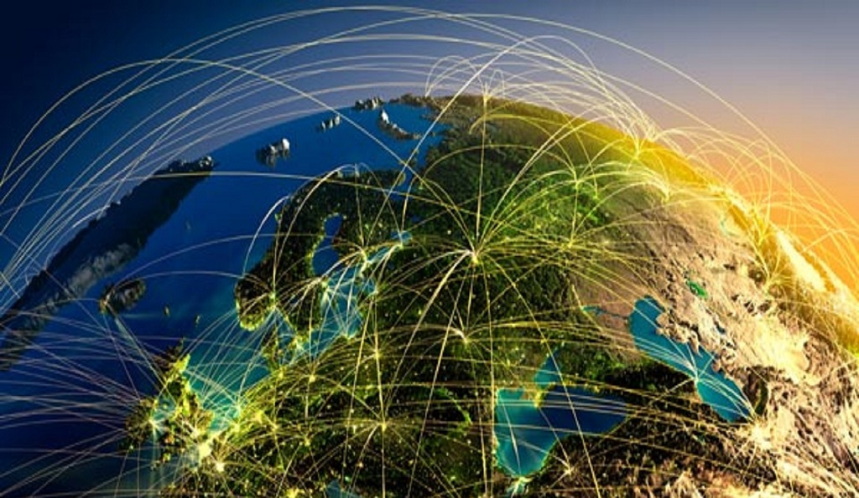

Slide 41
Daniel 但以理书 12.3
³ Those who have insight will shine brightly like the brightness of the firmament. And those who turn many to righteousness like the stars forever and ever.
³ 有智慧的人必发光，好像天上的光体；那些使许多人归义的必发光，如同星星，直到永永远远。

Slide 42
Daniel 但以理书 11.33
³³ Those who have insight among the people will give understanding to the many; yet they will fall by the sword and by flame, by captivity and by plunder, for days.
³³ 民中有智慧的人必使许多人明白；但他们必多日倒在刀剑之下，或被火烧，或被掳去，或被抢掠。

Slide 43
Matthew 马太福音 24.14
¹⁴ And this gospel of the kingdom will be preached in all the world as a witness to all the nations, and then the end will come.
¹⁴ 这天国的福音要传遍天下，向万民作见证，然后结局才来到。

Slide 44
Study prophecies Stay calm Preach gospel Help others repent Fix hope on the resurrection 学习末世预言 保持冷静 传福音 引导别人悔改 牢记复活的日子

Slide 46
Labour and childbirth a symbol of the end of this age 女人分娩 是这世代终结的一个象征

Slide 47
完

